Slide 1

Progress Seminar On WEBSITE ON HOGWARTS COLLEGE OF WITCHCHART AND WIZARDRY
Presented By
Pushpak Ashwin Fasate
Guided By
Mrs. Roshani Talmale
Department of Computer Science & Engineering
S. B. JAIN INSTITUTE OF TECHNOLOGY MANAGEMENT AND RESEARCH,NAGPUR
An Autonomous Institute, Affiliated to RTMNU, Nagpur

Slide 2
Contents
Objectives
Introduction
Website Design
Technology to be Used
Modules
Screenshots
Advantages & Applications
References
2
S. B. Jain Institute of Technology Management and Research

Slide 3
Objectives
To Reduce efforts of user.
To Provide full satisfaction to user.
To Provide easy access to the user.
3
S. B. Jain Institute of Technology Management and Research

Slide 4
Introduction
Websites are an excellent resource for open source software projects. A website should be something where the user wants to visit more. A website provides an ideal opportunity for users to learn more about our project. Users can access websites on a range of devices, including desktops, laptops, tablets, and Smartphone.
For this project, I created a website named as website on hogwarts collage of witchchart and wizardry in which I used HTML, CSS and JS programming language . Users will be able to use the website to know about hogwarts collage of witchchart and wizardry. In this website I created different sections / pages for detailed information about hogwarts.
S. B. Jain Institute of Technology Management and Research
4

Slide 5
Website Design: Flowchart
Hogwarts(Home)
Login
HOGWARTS CHRISTMAS
HOGWARTS BREAKFAST
gallery
HOGWART'S CLUBS
HOGWART'S COURSES
course
Quidditch
Triwizard Tournament
Dicover Your Patrous
Discover Your Wand.
The wand choses The Wizard
Sorting Hat
Hogwarts Clubs
Welcome To Hogwarts College
GRYFFINDER
RAVENCLAW
SLYTHERIN
HUFFLEPUFF
QUIDDITCH HOUSE CUP
THE TRIWIZARD TOURNAMENT
PROFESSOR SERVERUS SNAPE
PROFESSOR MINERVA MCGONAGALL
HOGWART'S EXPRESS
Login
Sign up
Sin up platform
Login platform
S. B. Jain Institute of Technology Management and research
5

Slide 6
Use case Diagram
WEL COME Hogwarts college Of Witchchart and Wizardry
Start
View navbar
Select item
Login
Register
View menu
Select page
View page
Close
S. B. Jain Institute of Technology Management and research

Slide 7
Technology to be Use
Front End:
HTML, CSS
IDE:
vs code
Hardware used:
Laptop , Computer and android phone
S. B. Jain Institute of Technology Management and research
7

Slide 8
Modules
Module Names
1. Home
2.Course
3.Gallery
4.log In
S. B. Jain Institute of Technology Management and Research
8

Slide 9
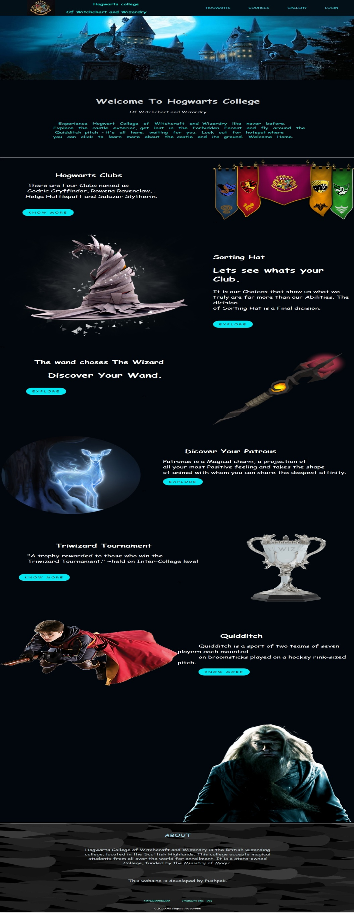

Screen Shots – Home Page
S. B. Jain Institute of Technology Management and Research
9

Slide 10
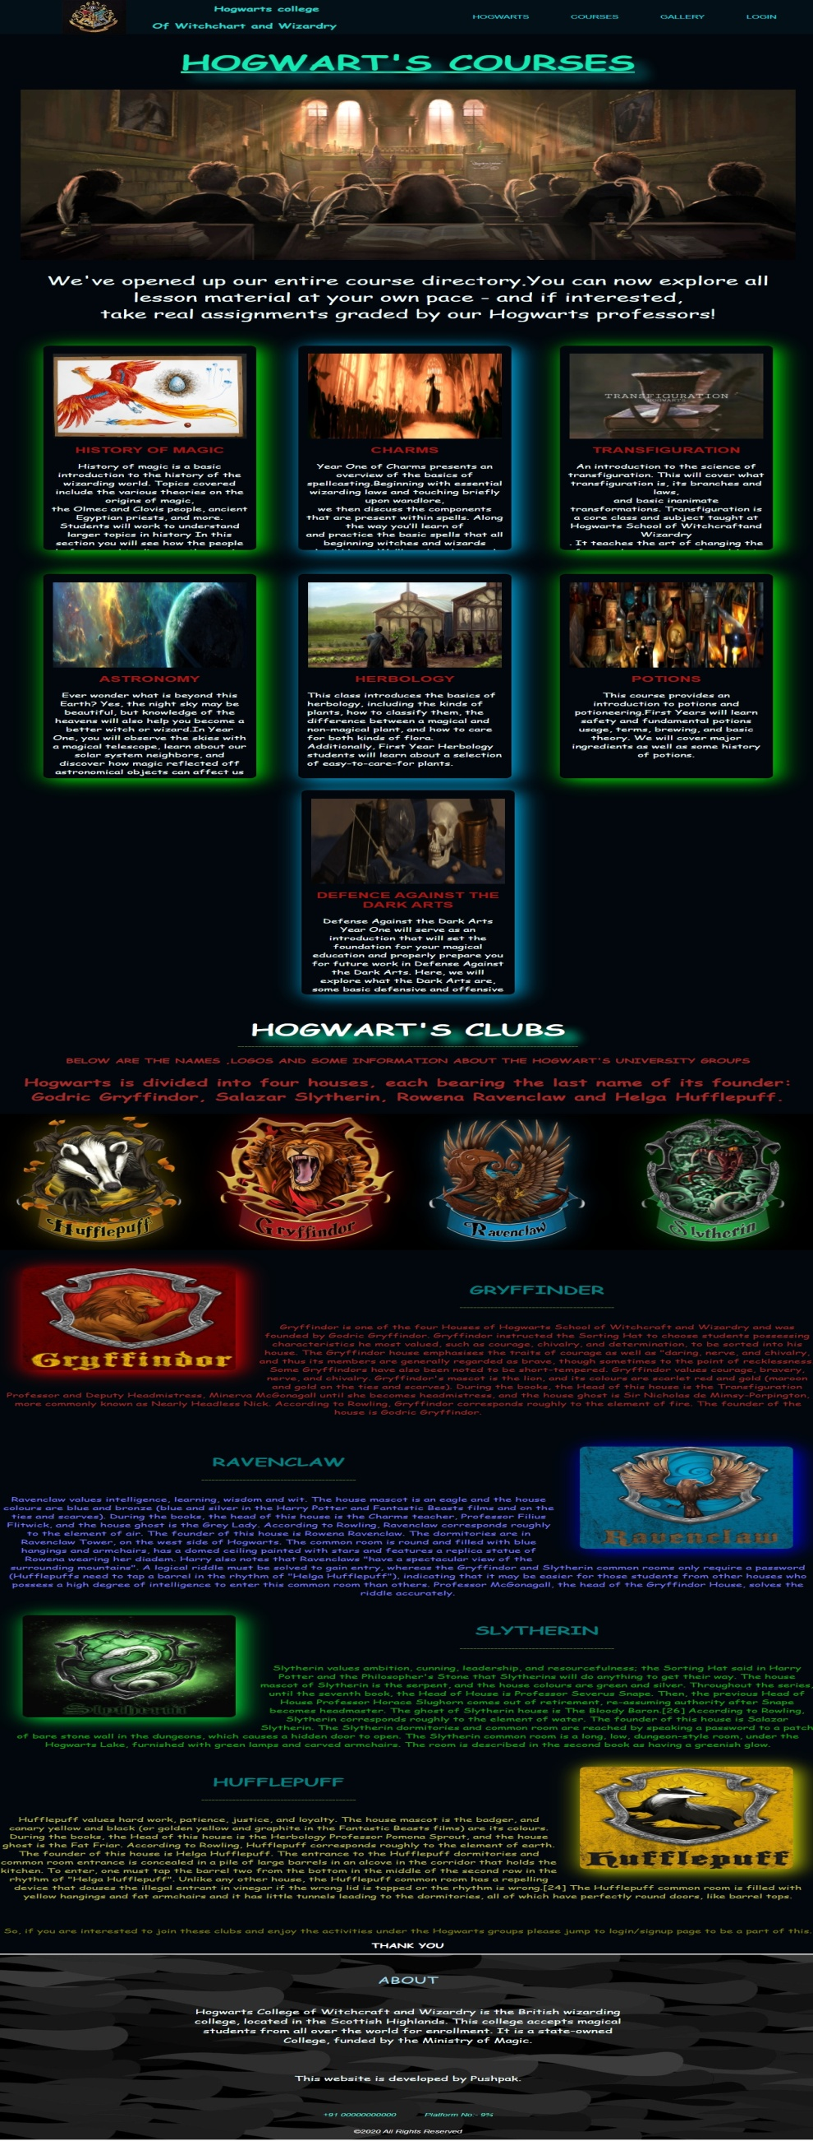

Courses Page

Slide 11
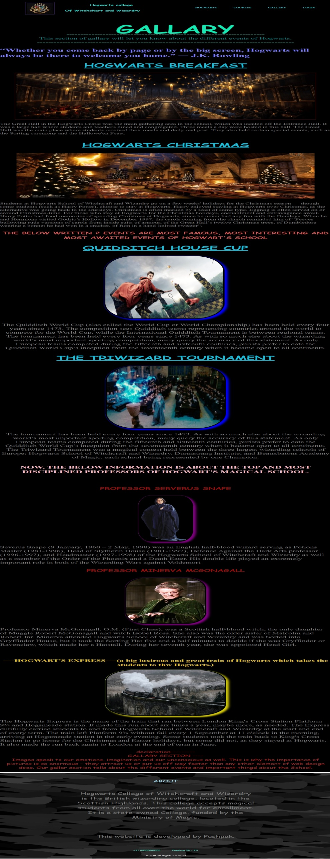
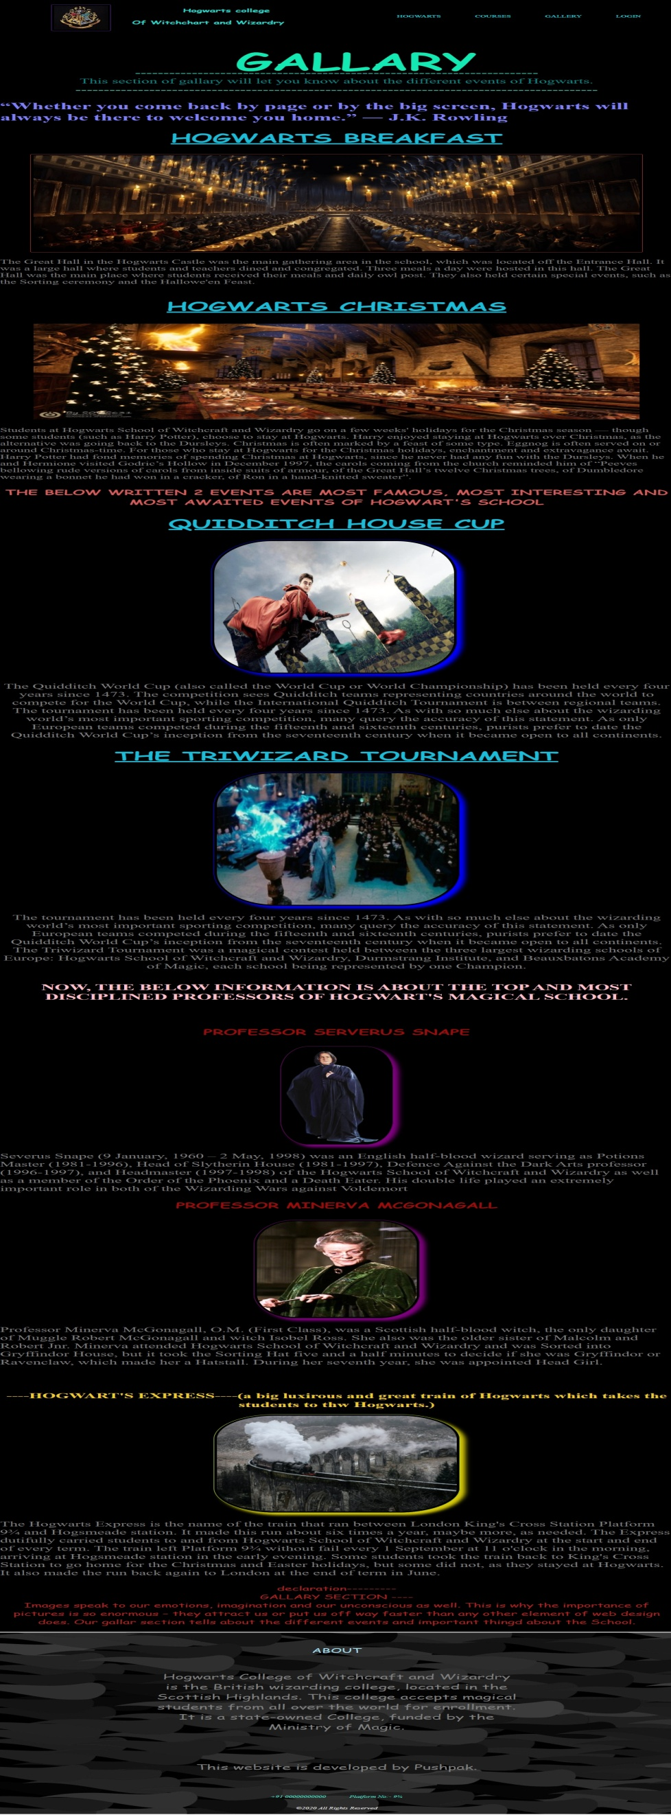
Gallery Page

Slide 12
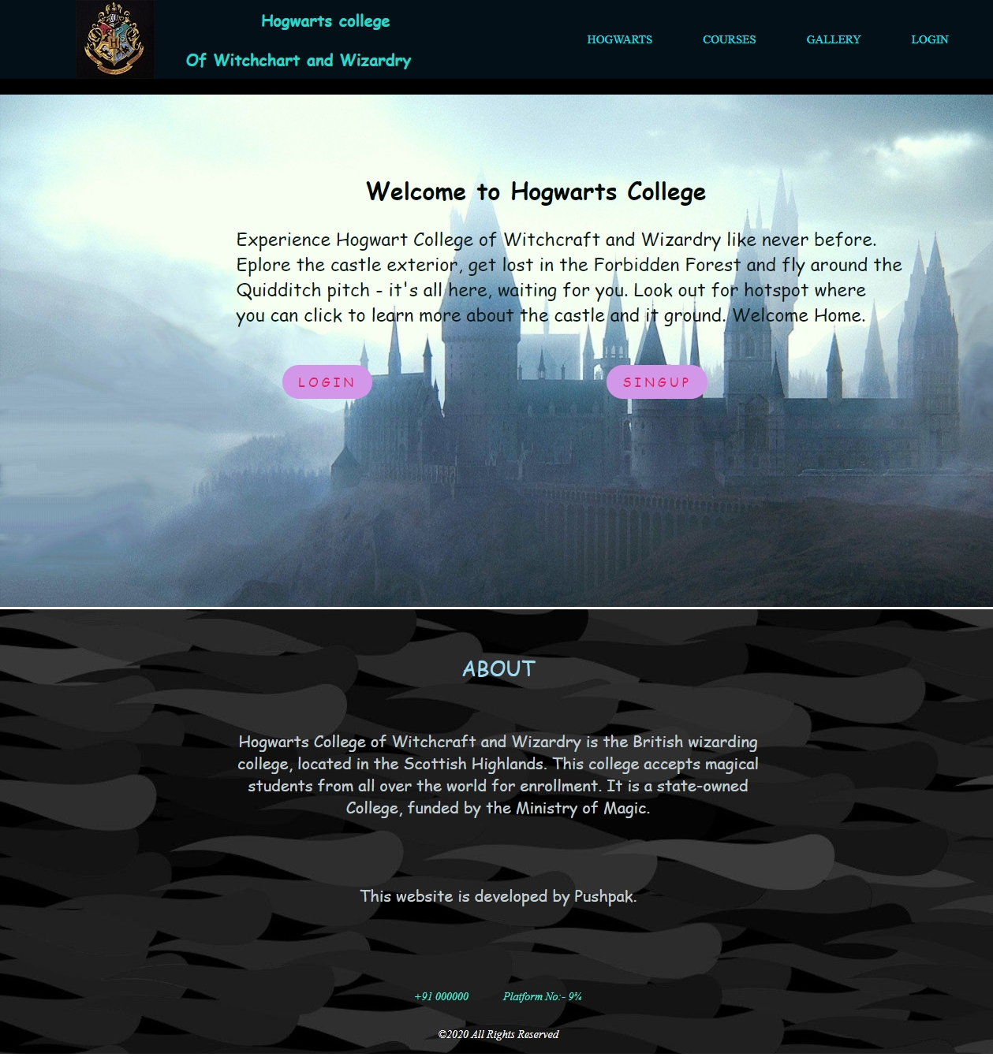
Login And Sign Page

Slide 13
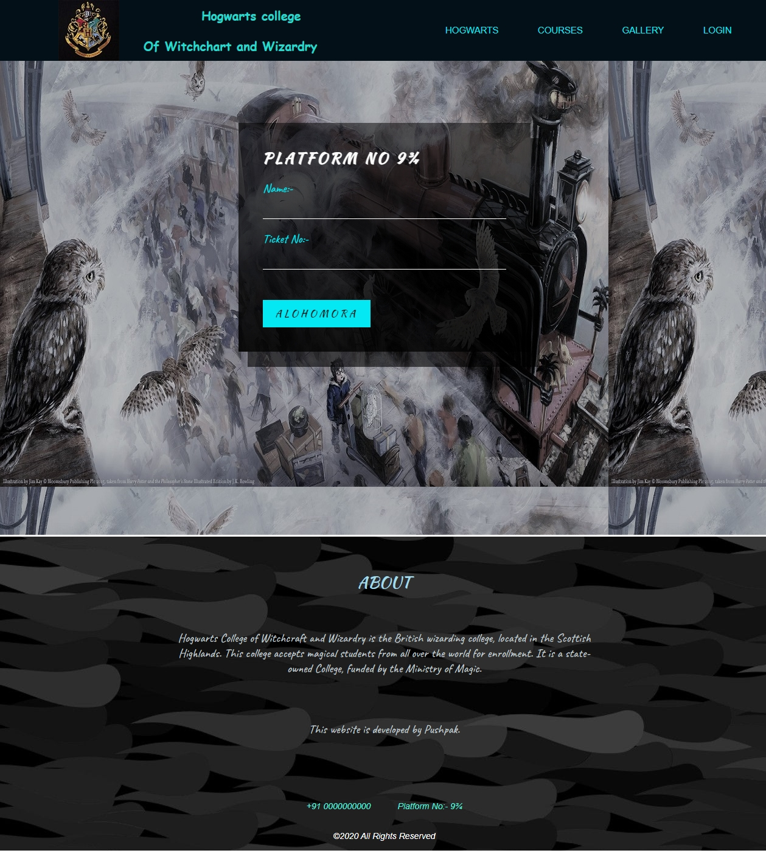
Login Page

Slide 14
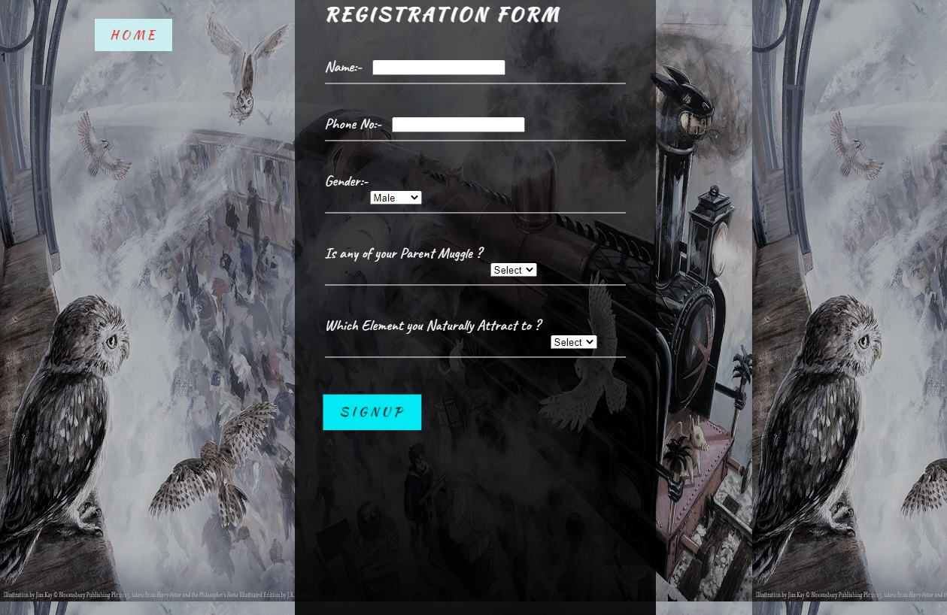
Sign Up Page

Slide 15
Advantages & Applications
Hogwarts college Of Witchchart and Wizardry
S. B. Jain Institute of Technology Management and Research
15

Slide 16
References
Websites:
www.w3schools.com
www.sololearn.com
www.greatlearning.in
www.geeksforgeeks.org
S. B. Jain Institute of Technology Management and Research
16

Slide 17
Thank You

